Slide 1
Assessing Policy Updates: Toward Trust-Preserving Intelligent User Interfaces
Matan Solomon
Ofra Amir
Omer Ben-Porat

Slide 2
Research Questions
RQ1: How do different demonstration strategies affect users’ ability to determine whether an update improved the agent’s policy, both in the same training context and across novel contexts?
RQ2: How do these strategies influence users’ broader judgments, including trust calibration and beliefs about the agent’s general capabilities?

Slide 3
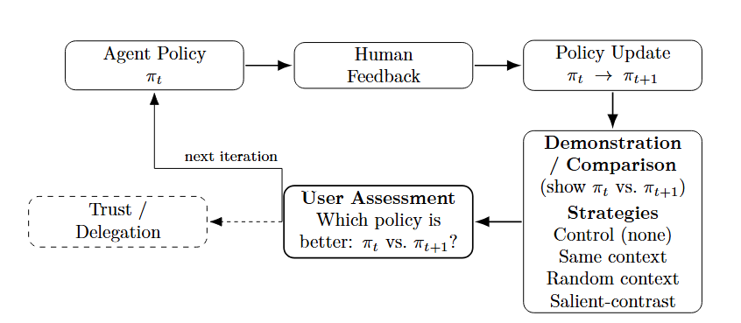
Preference-Based Reinforcement Learning

Slide 4
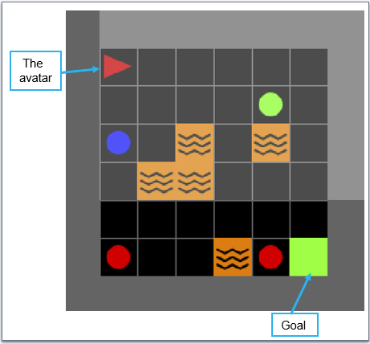
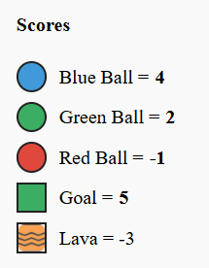
MiniGrid Environment

Slide 5
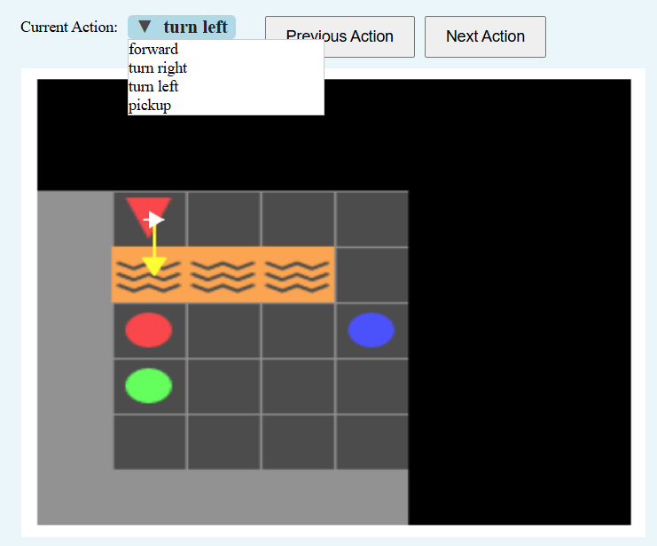
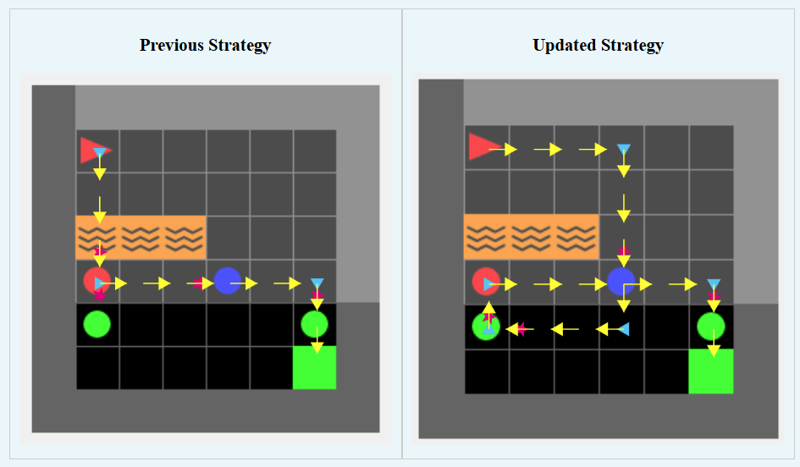
Policy Demonstration
User Feedback

Slide 6

Prolific Experiment
Around 300 participants into 4 groups:
Control – no demonstration, only saying the agent was updated.
Random - demonstration on a board drawn uniformly at random from a pre-generated pool of 18 evaluation boards
Same – demonstration on the same board on which feedback was given.
Salient-contrast: Demonstration on a board that maximizes the score difference between the two policies.

Slide 7
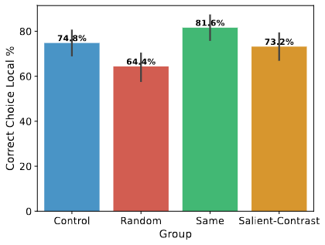
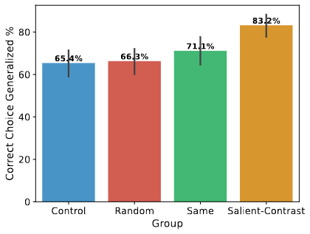
Results Correct Choice
Left: The user chooses the agent that got the higher score on the same board as the feedback.
Right: The User chose the agent that got the higher score on the average of fixed boards.

Slide 8
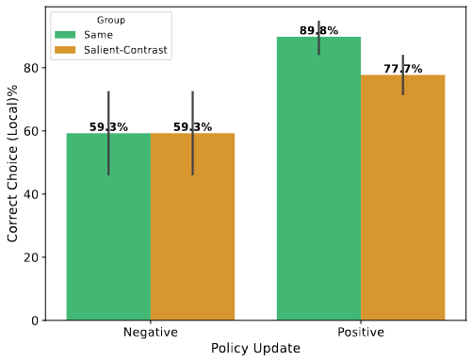
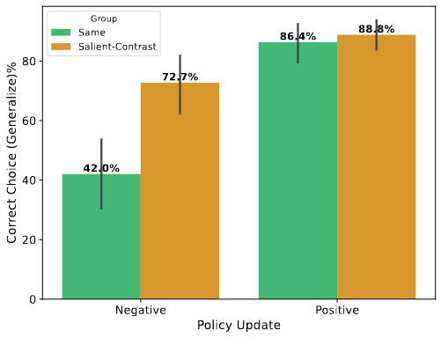
Results Correct Choice
Left: The user chooses the agent that got the higher score on the same board as the feedback.
Right: The User chose the agent that got the higher score on the average of fixed boards.

Slide 9
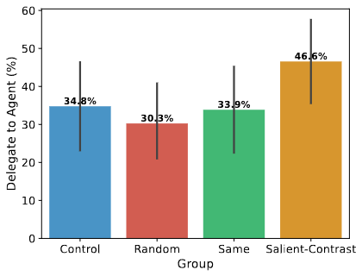
Results - Trust

